Slide 1
Pilot farms in denmark
SEGES P/S

Slide 2
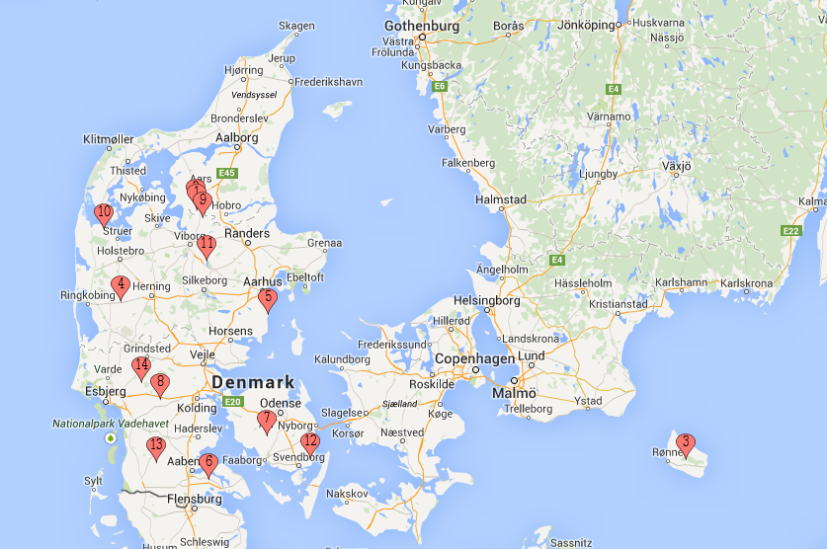
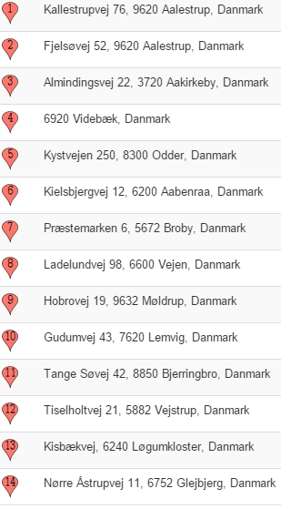
Pilot farms in Denmark

Slide 3
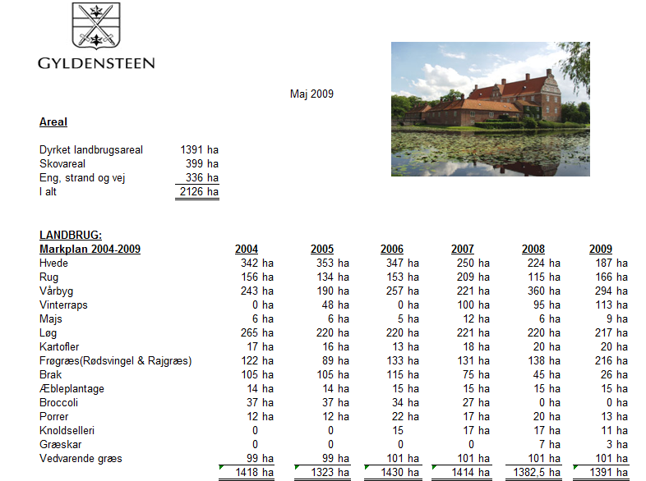

Slide 4
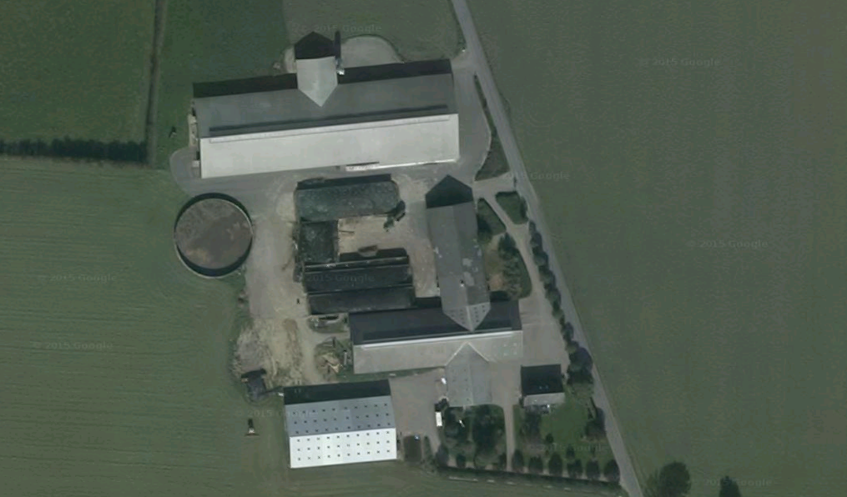
Mosegaarden I/S – dairy farm with +200 hectares and 220 cows using AMS

Slide 5
Tange outdoor market garden ciltivates approximately 1000 hectares of which 450 hectares are used for growing carrots.

